Slide 1
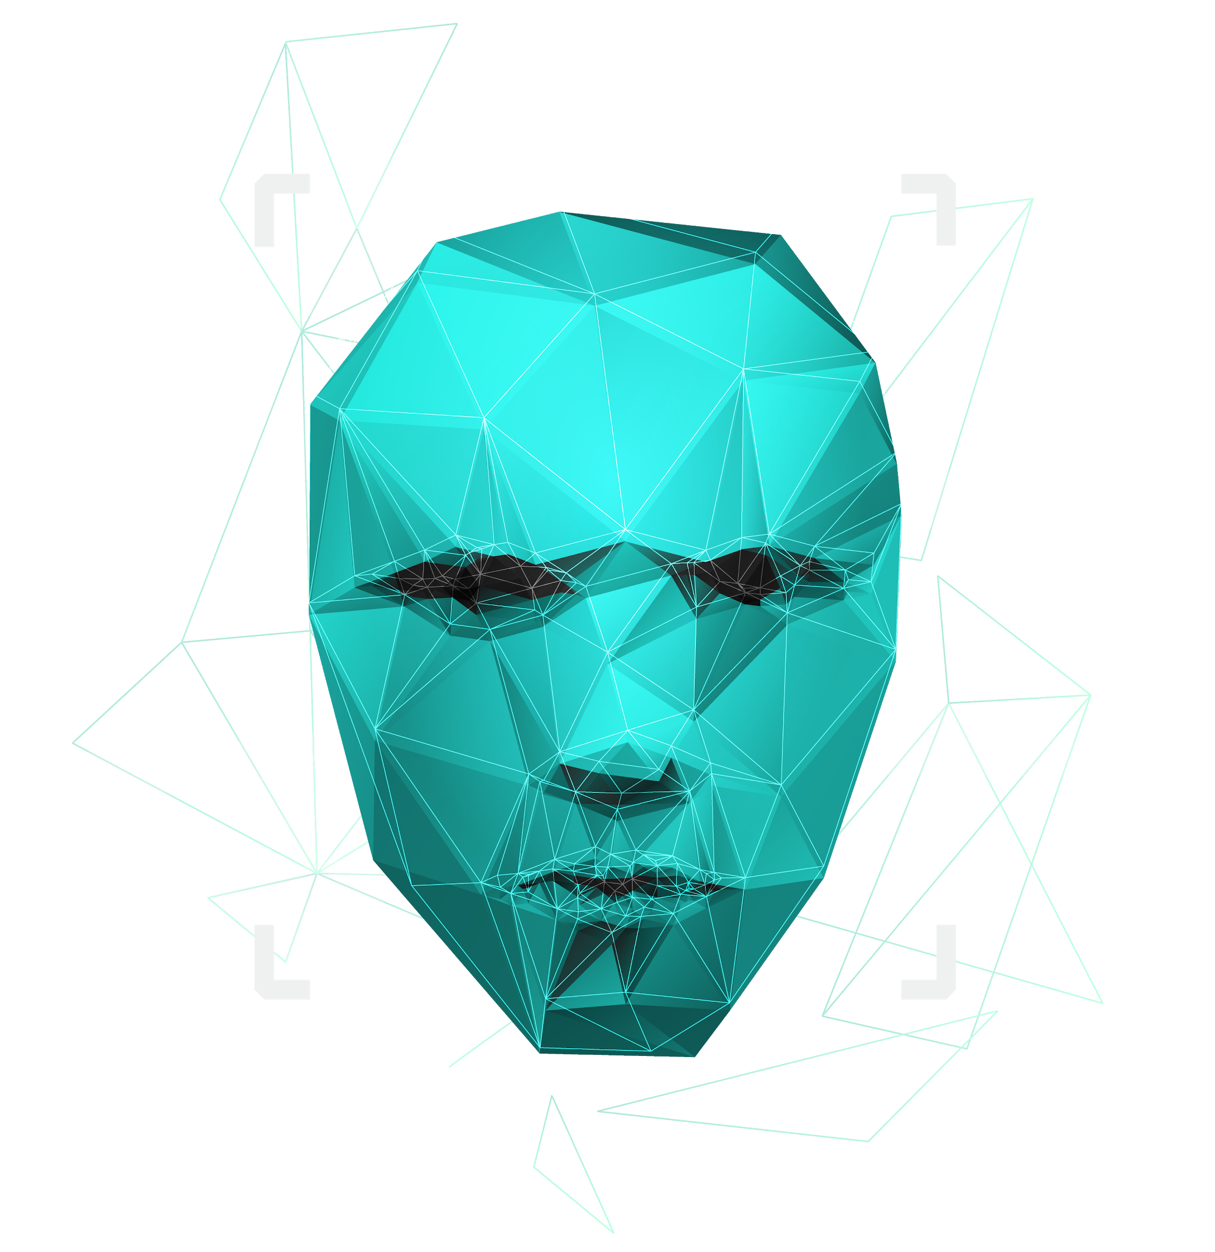
RECOMMENDATION SYSTEM
International Institute of Information Technology , Hyderabad
GROUP NO. 30
Project Guide: Prof. Charu Sharma
Presented By :
1) Sumeet Agrawal
2) Piyush Singh
3) Lokesh Sharma
4) Mayush Kumar

Slide 2
Roles and Responsibilities
Sumeet Agrawal:
Responsible for fetching data based on search input.
Mainly dealing with Elastic Search , Transformer+Bert.
Piyush Singh:
Responsible for Front End of the project.
Mainly dealing with React, Bootstrap etc..
Mayush Kumar:
Responsible for Back End of the Project.
Mainly dealing with MongoDB, express, Node JS etc.
Lokesh Sharma:
Responsible for Connectivity between all the components of the project.
Mainly dealing with express, API’s, Node JS, Handle bars etc.

Slide 3
Abstract
Developing a Recommendation System for Research papers using Python, MERN stack, and Elastic search and Kaggle Dataset. We will be recommending research papers based on user search history. Here user can login into their accounts and then can search for any research paper or for any topic which will be stored into our history database on mongodb. We will only be storing history data of last 15 searches only. Then we will use the history data on which we will apply elastic search and then from it the nearest results we get from our research paper dataset will be recommended to the user.

Slide 4
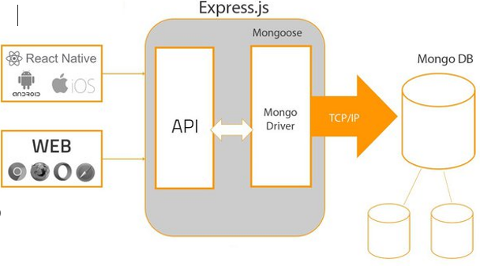
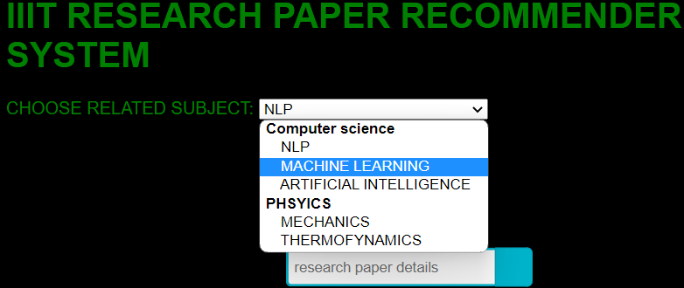
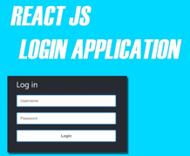
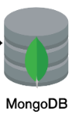

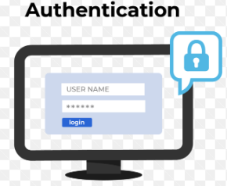



BASIC ARCHITECTURE FLOW
Results with links to acess..

Slide 5
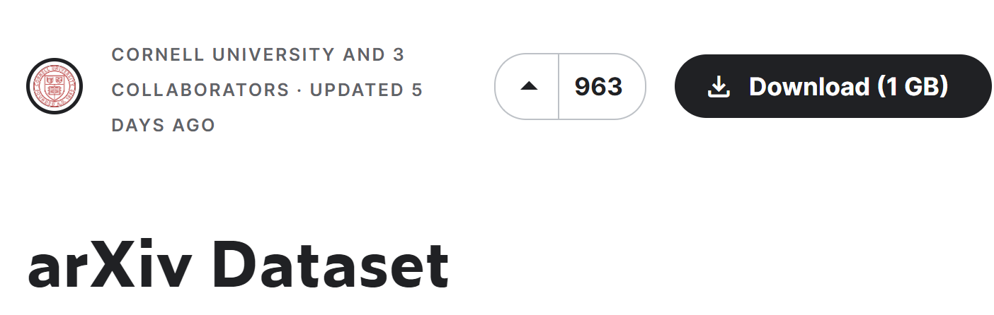

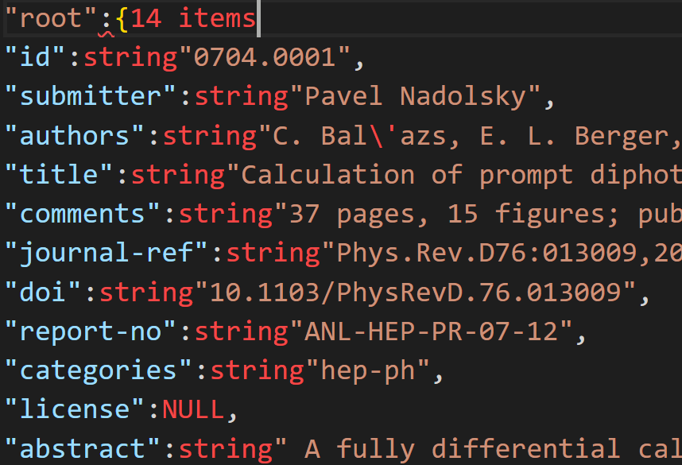
Metadata
Database from:-
222
How Data is stored : -
2 million Datasets.

Slide 6
Project Flow
We have 2 million datasets for our project (roughly around 3GB size) .
We pre-processed those datasets and converted them into vector of dimension 384 and stored locally (around 15GB size) and the input text entered by user will be converted into a vector of dimension 384 on the fly and will be compared with pre processed vectors stored offline . The cosine distance between these vectors will be calculated and top 10 results will be shown to user.
Why Elastic Search?
Searching large datasets were taking huge amount of time in MongoDB ,so we needed some technology which can do this job is less time, so we implemented elastic search and the results were quite impressive.
Front End:
We have worked on UI and created the basic pages through which our user can login, sign up or see their profiles.
Back End:
We are also connected with MongoDB through which we can send the user info to database.

Slide 7
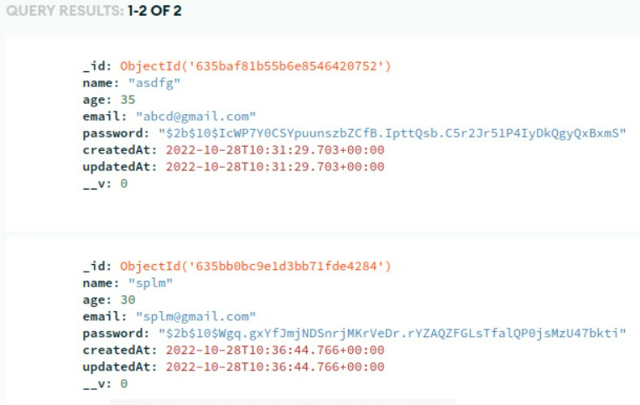
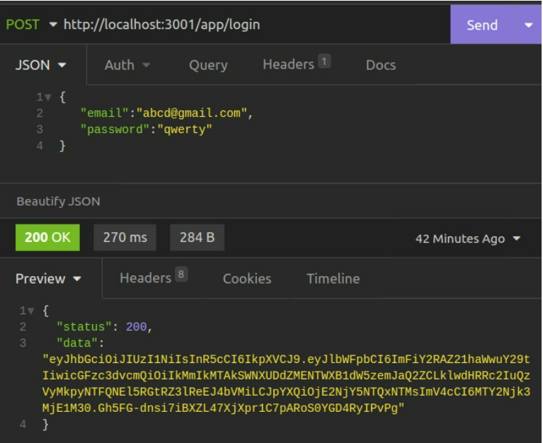
Work Progress

Slide 8
Work that needs to be done
We now have to integrate out front end and back end.
We have to integrate APIs through which we can run the python scripts that allows us to recommend research paper to user on our main application.

Slide 9
-Thank You-

